Slide 1
Presentation to the 9th Performance Audit Seminar on IT Audit Information Technology Security Audit Auditing Cyber Resilience in the Australian Government context April 2019 Based on the ANAO Audit Report No.53 2017-18 Cyber Resilience

Slide 2
Agenda
The Australian Government context
ANAO audits
Changes
The future

Slide 3
This is a continuing area of interest for Parliament
Recent reports from the press
February 2019 - hackers targeted political parties in attack on Parliament's servers
January 2019 – State Government employee directory accessed by unauthorised party
November 2018 - cyber security breach and extortion attempt on Australia defence contractor

Slide 4
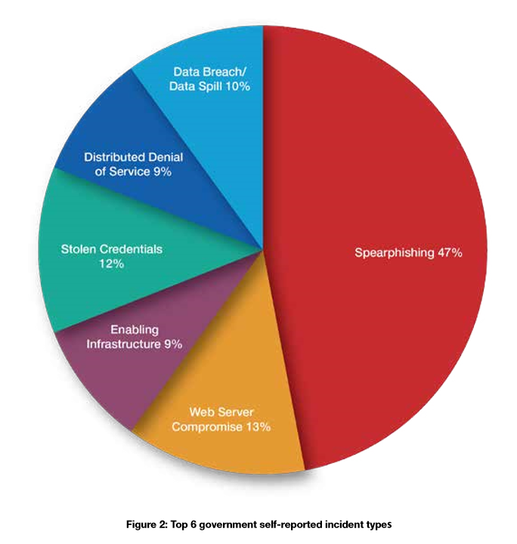
Top 6 cyber intrusion types
Source: ACSC Threat Report 2017

Slide 5
Strategies to Mitigate Cyber Security Incidents
Published by Australian Signals Directorate since 2010
Based on lessons learned from their visibility of cyber security incidents, vulnerabilities and adversary techniques
Regularly updated to address evolving landscape
Per ASD, correct implementation of the current version would have effectively prevented, or minimised the extent of, compromise to the victim network in every case they have investigated over the past few years

Slide 6
Australian Government Cyber Security Framework
Regulatory framework in Commonwealth government – Protective Security Policy Framework
Detailed standards, guidelines and mandatory cyber security requirements based on ASD Strategies
Self-assessment reporting process

Slide 7
ANAO Audits
The ANAO has issued four reports on Australian Government entities’ compliance with the ISM and their overall cyber resilience
No.50 2013-14 Cyber Attacks: Securing Agencies’ ICT Systems
No.37 2015-16 Cyber Resilience
No.42 2016-17 Cybersecurity Follow-up Audit
No.53 2017-18 Cyber Resilience
Copies of these reports are available from the ANAO website: www.anao.gov.au

Slide 8
ANAO Audits - approach
Audit approach – “Compliance Plus”
Audit criteria and assessment standard
Government mandatory cyber security requirements
Foundation ICT control framework (ITGC)
A wide coverage of government entities
Detailed examination of cybersecurity measures at various technical levels

Slide 9
ANAO Audits - outcomes
2014: 0/7 entities compliant
2016: 2/4 entities compliant
2017: 1/3 entities compliant
2018: 1/3 entities compliant

Slide 10
ANAO Audits - outcomes
Cyber Resilient
Embedded in business process
Externally Resilient
Controls in place
Compliance with the Top Four mitigation strategies
Actively implementing
Controls not in place
Vulnerable
Internally Resilient
IT General Controls not met
IT General Controls met
Maturity in Logical Access & Change Management

Slide 11
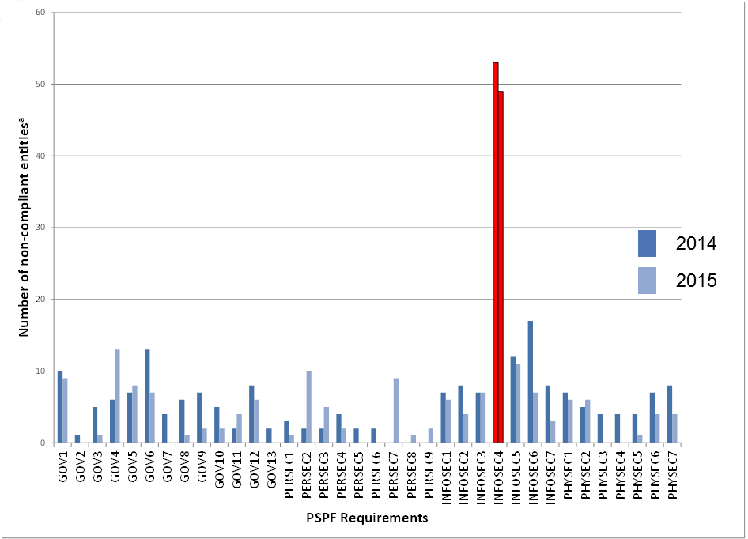
Entity self-assessment
In 2014 and 2015, cyber security controls had the highest incidents of non-compliance among all PSPF requirements

Slide 12
Entity self-assessment
In 2017, cyber security controls continued to have the lowest levels of compliance

Slide 13
ANAO vs entity self-assessment

Slide 14
The Joint Committee of Public Accounts and Audit response to these audits
In March 2015, the Committee recommended that the ANAO consider including regular audits, in its schedule of performance audits, of Commonwealth entities’ compliance with the top four mitigation strategies as well as Commonwealth entities’ overall security posture.
In March 2017, the Committee recommended that in future audits on cybersecurity compliance, the ANAO outline the behaviours and practices it would expect in a cyber resilient entity, and assess against these.

Slide 15
Culture - approach
Focus on behaviours and practices that provide an indicator of culture
Identify what compliant entities have in common
Identify related characteristics of less mature entities
Draw on findings from related audits

Slide 16
What compliant entities had in common
Established an ICT governance framework that incorporates cyber security
Have a risk based approach to manage cyber security investment
Clearly defined management roles and responsibilities for cyber security
Obtained the right skillset and expertise for cyber security
Embed cyber security in the entity culture

Slide 17
Culture – key findings
Governance and risk management
Including leadership and accountability
Roles and responsibilities
Including knowledge, skills and abilities
Technical support
Assessment of status

Slide 18
Where to from here?
Recommendation 2 of the 2018 report was to …improve compliance with the framework by:
providing adequate technical guidance to support entities to accurately self-assess compliance with the Top Four mitigation strategies and their underlying controls contained in the Information Security Manual;
developing a program for verifying entities’ reported compliance with the mandatory cyber security requirements; and
increasing transparency and accountability about entities’ compliance with those requirements.

Slide 19
Current status
Update to PSPF published in October 2018, which included additional guidance on implementation of requirements.
Updates to ISM and other guidance material
Additional reporting requirements in relation to self-assessment
Summary report on whole-of-Government security posture based on entity self-assessment to be published in 2020

Slide 20
Some Ongoing Challenges
Increasingly sophisticated cyber attacks
Technology evolution is accelerating business digitisation and connection
Change of legislation and government policy requirement
Citizens and customers’ expectation
Cyber security skill shortage
Achieving compliance

Slide 21
Key Messages
Cyber resilience is a journey
Start from executive commitment
Utilise existing standards and compliance frameworks
Implement proven workable strategies
Culture is an integral part of cyber resilience – “compliance plus”

